Slide 1
CITY OF RIVERSIDE PERMIT PORTAL
HOW TO SUBMIT A
FIRE SPECIAL EVENT
APPLICATION

Slide 2
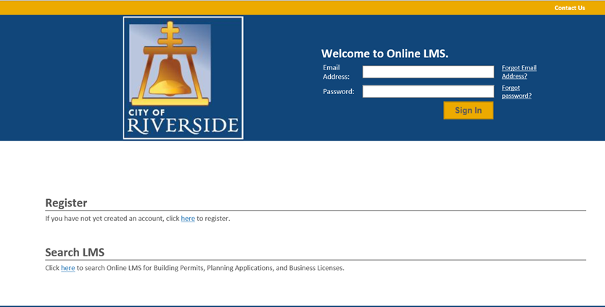
HOW TO SUBMIT A FIRE SPECIAL EVENT PERMIT APPLICATION
If you are a NEW USER, you will need to set up a new user login in the system in order to access your activities
If you are a RETURNING USER, sign in using your email address and password
Once registered, ensure you sign up for email notification for real time status updates under your “Profile” at the top right of the home screen

Slide 3
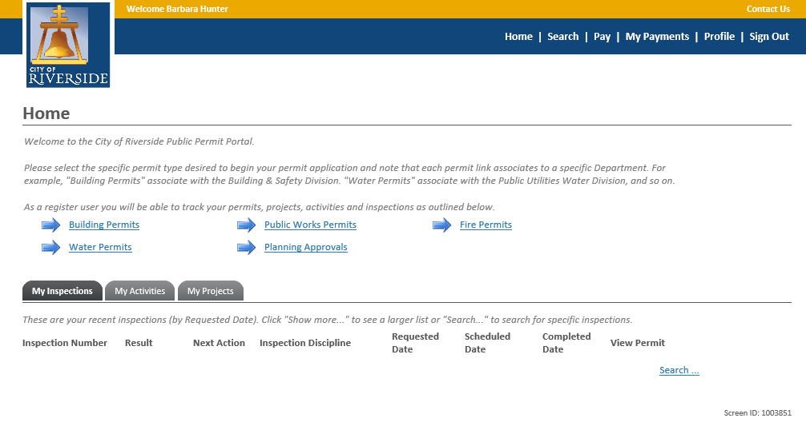
HOW TO SUBMIT A FIRE SPECIAL EVENT PERMIT APPLICATION
To submit a FIRE SPECIAL EVENT PERMIT APPLICATION, begin at the HOME page and click on FIRE PERMITS

Slide 4
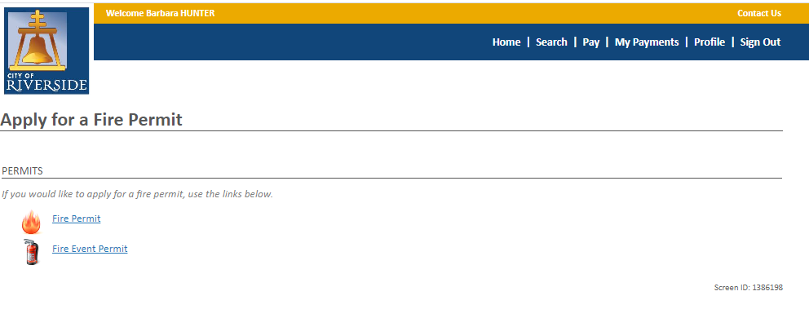
HOW TO SUBMIT A FIRE SPECIAL EVENT PERMIT APPLICATION
Next, select FIRE EVENT PERMIT

Slide 5
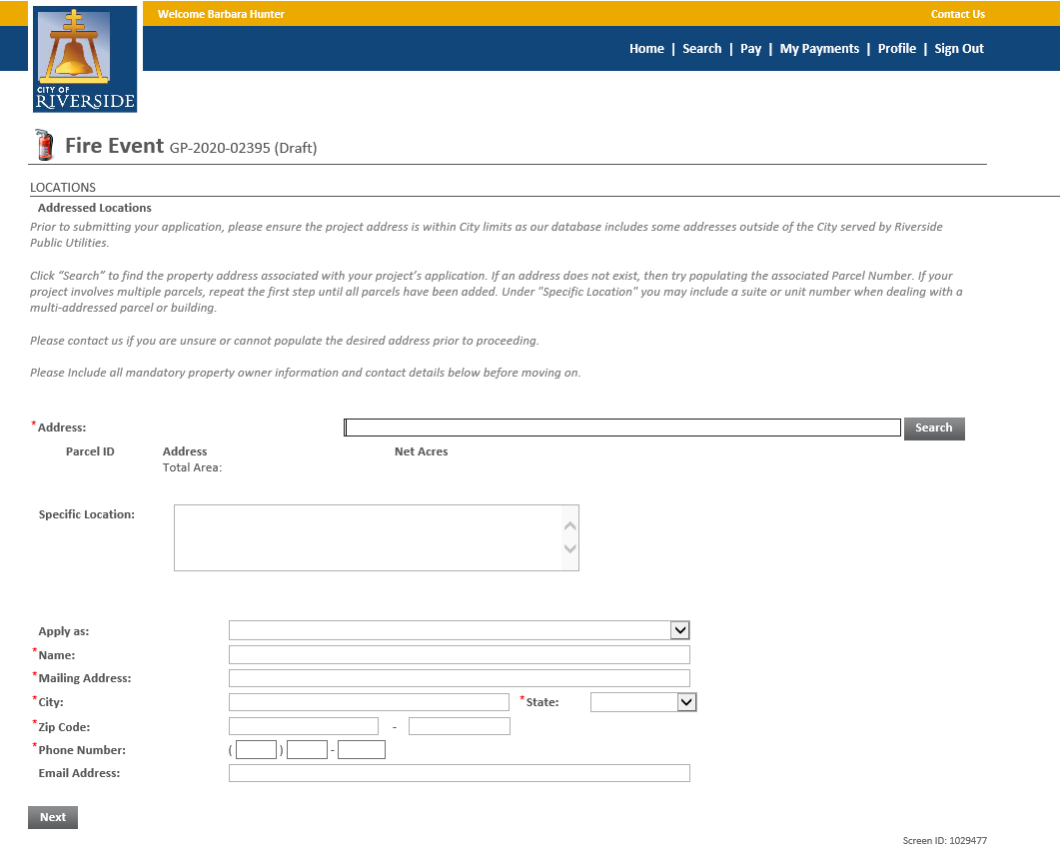
HOW TO SUBMIT A FIRE SPECIAL EVENT PERMIT APPLICATION
Select the ADDRESS where the event will take place
You may also search by Parcel Number
Click SEARCH ( follow next steps on the pop-up window)
Check the box Address / Parcel where the event will be taking place
Click Select
Enter the PROPERTY OWNER information
Click NEXT

Slide 6
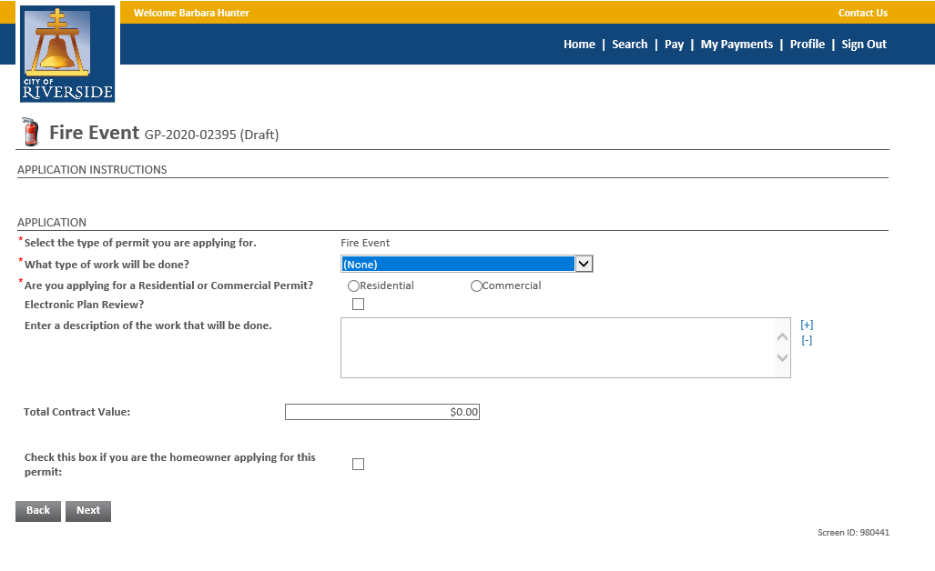
HOW TO SUBMIT A FIRE SPECIAL EVENT PERMIT APPLICATION
Click the dropdown to select the type of PERMIT
FIRE- SPECIAL EVENT
Check the box for the type of event - RESIDENTIAL or COMMERCIAL
Enter a description of the event that is being proposed. Please be brief but descriptive.
Click NEXT to continue

Slide 7
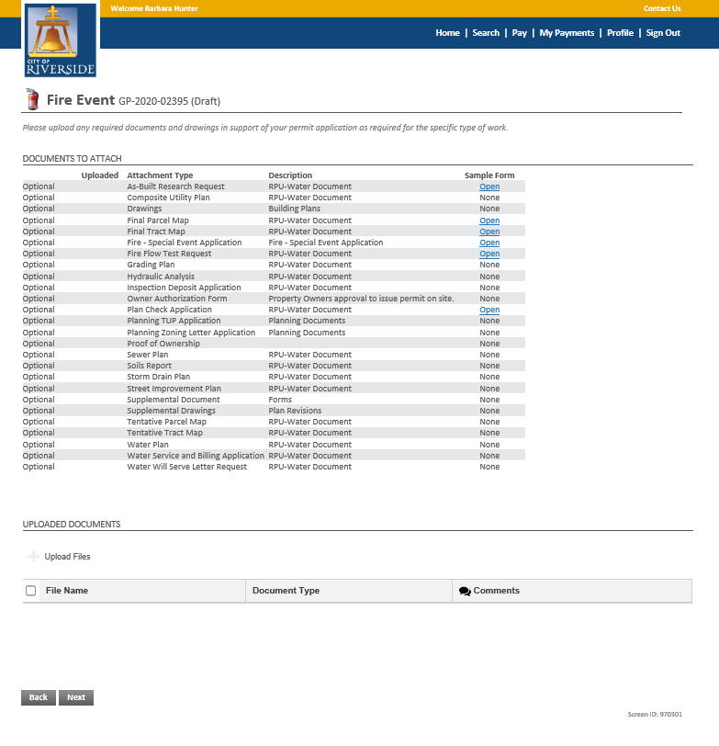
HOW TO SUBMIT A FIRE SPECIAL EVENT PERMIT APPLICATION
Select the FIRE- SPECIAL EVENT APPLICATION (Signature is required on your application)
If you have required documents to support the permit application, such as required forms, flame resistant cert, site/layout maps, etc., you may upload those here
Click UPLOAD FILES to upload documents from your File Explorer
Or, you may drag and drop selected files in the section below marked DROP FILES HERE.
When complete, click NEXT.
Drop Files Here

Slide 8
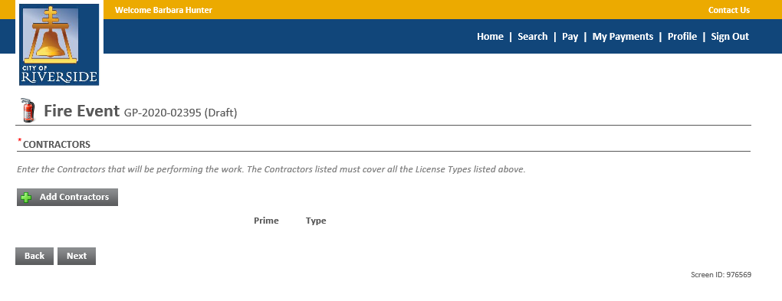
HOW TO SUBMIT A FIRE SPECIAL EVENT PERMIT APPLICATION
Click NEXT to continue

Slide 9
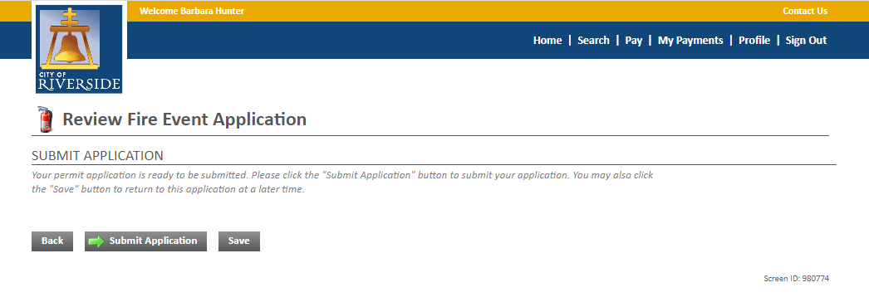
HOW TO SUBMIT A FIRE SPECIAL EVENT PERMIT APPLICATION
Your application is now ready to submit
You may use the BACK buttons to review your application or add any missing information
You may click SAVE to save without submitting
Click SUBMIT APPLICATION to complete the process
You will receive a confirmation of the receipt of your permit application.

Slide 10
CITY OF RIVERSIDE PERMIT PORTAL
THANKS FOR
WATCHING!
FOR FURTHER ASSISTANCE, CONTACT THE CITY OF RIVERSIDE ONE STOP SHOP 951-826-5800

